Slide 1

15CSE313 Software Engineering
Requirements Modeling
Dr C.Arunkumar
Assistant Professor(Sr.Gr), Dept of Computer Science and Engg
Amrita Vishwa Vidyapeetham, Coimbatore

Slide 2
Requirements Modeling
Pressman R S, Bruce R.Maxim, “Software engineering - A Practitioner’s Approach”, Eighth Edition, Tata McGraw-Hill, 2014
Chapter 8: 9.1-9.4, 11.1,11.5

Slide 3
Topics Covered
Topic | Text Book Reference
Requirements Analysis | 9.1
Scenario based Modeling | 9.2
UML Model that supplement the use case | 9.3
Creating a Behavioral Model | 11.1
Identifying events with the use case | 11.2
State Representations | 11.3
Patterns for Requirements Modeling | 11.4
Requirements Modeling for Web and Mobile Apps | 11.5

Slide 4
Requirements Analysis
Requirements analysis results in the specification of software’s operational characteristics, indicates software’s interface with other system elements, and establishes constraints that software must meet
Requirements analysis allows you (regardless of whether you’re called a software engineer, an analyst, or a modeler ) to elaborate on basic requirements established during the inception, elicitation, and negotiation tasks that are part of requirements engineering

Slide 5
Requirements Modeling Results in one or more of the following types of models
Scenario-based models
Class-oriented models
Behavioral and patterns-based models
Data models
Flow-oriented models
of requirements from the point of view of various system “actors.”
that represent object-oriented classes (attributes and operations) and the manner in which classes collaborate to achieve system requirements.
that depict how the software behaves as a consequence of external “events.”
that depict the information domain for the problem.
that represent the functional elements of the system and how they transform data as they move through the system.

Slide 6
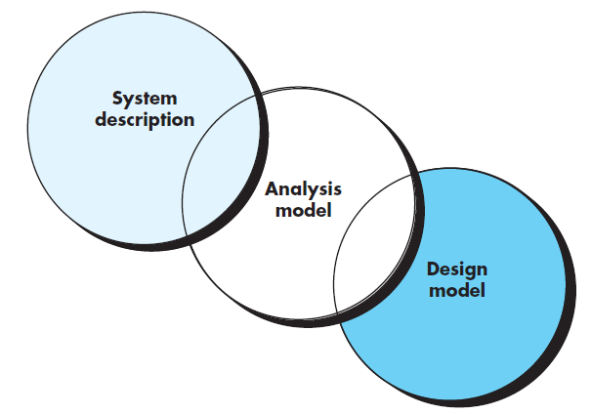
Objectives of requirements modelling
to describe what the customer requires
to establish a basis for the creation of a software design
to define a set of requirements that can be validated once the software is built
The analysis model bridges the gap between a system-level description that describes overall system or business functionality as it is achieved by applying software, hardware, data, human, and other system elements and a software design that describes the software’s application architecture, user interface, and component-level structure

Slide 7
Analysis Rules of Thumb
The model should focus on requirements that are visible within the problem or business domain. The level of abstraction should be relatively high.
Each element of the requirements model should add to an overall understanding of software requirements and provide insight into the information domain, function, and behavior of the system.
Delay consideration of infrastructure and other nonfunctional models until design. That is, a database may be required, but the classes necessary to implement it, the functions required to access it, and the behavior that will be exhibited as it is used should be considered only after problem domain analysis has been completed.

Slide 8
Analysis Rules of Thumb
Minimize coupling throughout the system. It is important to represent relationships between classes and functions. However, if the level of “interconnectedness” is extremely high, efforts should be made to reduce it.
Be certain that the requirements model provides value to all stakeholders. Each constituency has its own use for the model. For example, business stakeholders should use the model to validate requirements; designers should use the model as a basis for design; QA people should use the model to help plan acceptance tests.
Keep the model as simple as it can be. Don’t add additional diagrams when they add no new information. Don’t use complex notational forms when a simple list will do.

Slide 9
Domain Analysis
Software domain analysis is the identification, analysis, and specification of common requirements from a specific application domain, typically for reuse on multiple projects within that application domain . . .
[Object-oriented domain analysis is] the identification, analysis, and specification of common, reusable capabilities within a specific application domain, in terms of common objects, classes, subassemblies, and frameworks

Slide 10
Domain Analysis
The “specific application domain” can range from avionics to banking, from multimedia video games to software embedded within medical devices
The goal of domain analysis is straightforward: to find or create those analysis classes and/or analysis patterns that are broadly applicable so that they may be reused

Slide 11
Discussion
Is Domain analysis an Umbrella Activity?

Slide 12
Domain Analysis == Umbrella Activity
Domain analysis may be viewed as an umbrella activity for the software process
By this we mean that domain analysis is an ongoing software engineering activity that is not connected to any one software project
In a way, the role of a domain analyst is similar to the role of a master toolsmith in a heavy manufacturing environment
The job of the toolsmith is to design and build tools that may be used by many people doing similar but not necessarily the same jobs
The role of the domain analyst is to discover and define analysis patterns, analysis classes, and related information that may be used by many people working on similar but not necessarily the same applications

Slide 13
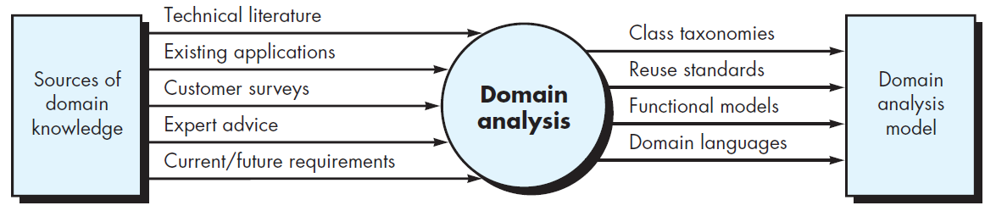
Key inputs and outputs for the domain analysis process

Slide 14
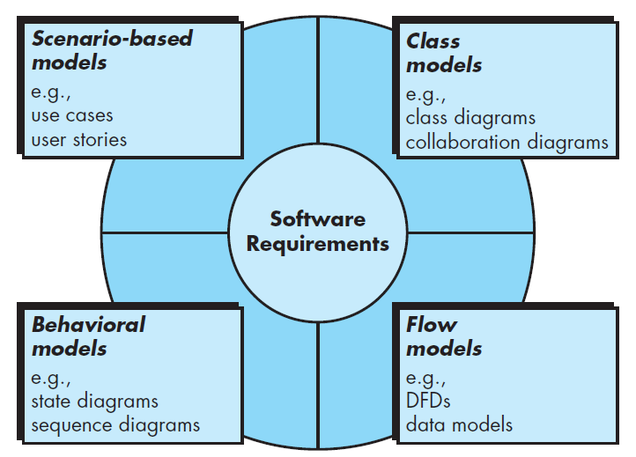
Elements of the Analysis Model

Slide 15
Scenario based Modelling
Although the success of a computer-based system or product is measured in many ways, user satisfaction resides at the top of the list
If you understand how end users (and other actors) want to interact with a system, your software team will be better able to properly characterize requirements and build meaningful analysis and design models
Hence, requirements modeling with UML begins with the creation of scenarios in the form of use cases, activity diagrams, and swimlane diagrams

Slide 16
Creating a Preliminary Use Case What to write about?
The first two requirements engineering tasks—inception and elicitation—provide you with the information you’ll need to begin writing use cases
Requirements-gathering meetings, quality function deployment (QFD), and other requirements engineering mechanisms are used to identify stakeholders, define the scope of the problem, specify overall operational goals, establish priorities, outline all known functional requirements, and describe the things (objects) that will be manipulated by the system

Slide 17
Creating a Preliminary Use Case What to write about?
The SafeHome home surveillance function (subsystem) identifies the following functions that are performed by the homeowner actor:
Select camera to view.
Request thumbnails from all cameras.
Display camera views in a PC window.
Control pan and zoom for a specific camera
Selectively record camera output
Replay camera output
Access camera surveillance via the Internet

Slide 18
Creating a Preliminary Use Case Refining a Preliminary Use Case
A description of alternative interactions is essential for a complete understanding of the function that is being described by a use case. Therefore, each step in the primary scenario is evaluated by asking the following questions:
Can the actor take some other action at this point?
Is it possible that the actor will encounter some error condition at this point? If so, what might it be?
Is it possible that the actor will encounter some other behavior at this point (e.g., behavior that is invoked by some event outside the actor’s control)? If so, what might it be?
Answers to these questions result in the creation of a set of secondary scenarios that are part of the original use case but represent alternative behavior

Slide 19
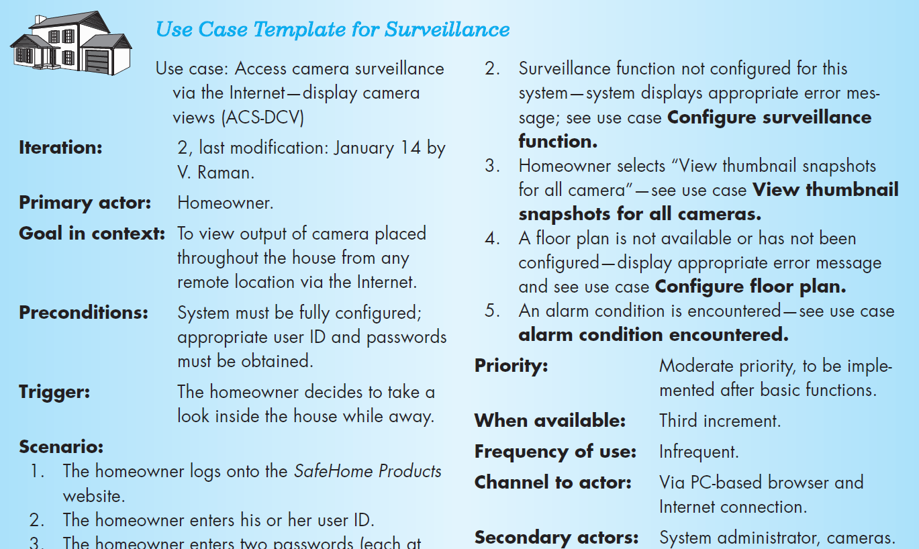
Creating a Preliminary Use Case Writing a Formal Use Case – Refer text Page 179

Slide 20
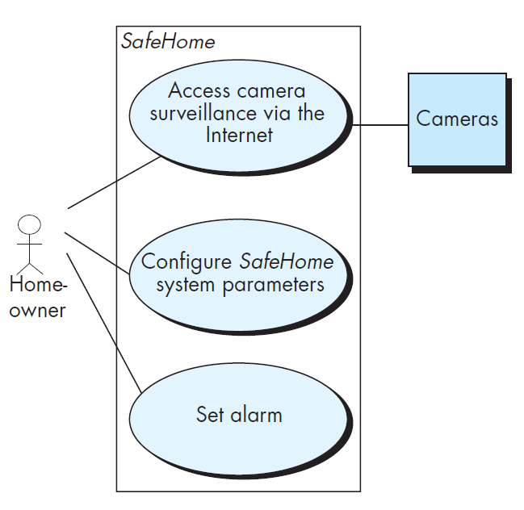
Preliminary use case diagram for the SafeHome system

Slide 21
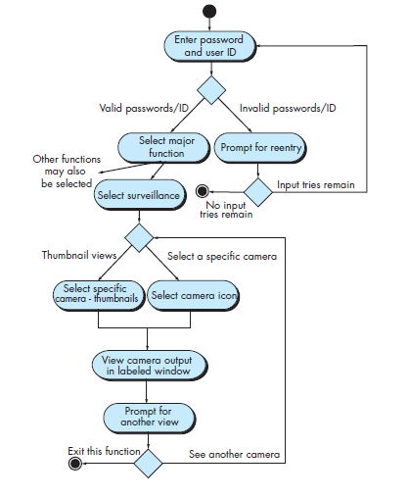
Developing an Activity Diagram
The UML activity diagram supplements the use case by providing a graphical representation of the flow of interaction within a specific scenario
It should be noted that the activity diagram adds additional detail not directly mentioned (but implied) by the use case
For example, a user may only attempt to enter userID and password a limited number of times
This is represented by a decision diamond below “Prompt for reentry.”

Slide 22
Creating a Behavioural Model
The behavioral model indicates how software will respond to external events
To create the model, you should perform the following steps
Evaluate all use cases to fully understand the sequence of interaction within the system,
identify events that drive the interaction sequence and understand how these events relate to specific objects
create a sequence for each use case,
build a state diagram for the system, and
review the behavioral model to verify accuracy and consistency

Slide 23
IDENTIFYING EVENTS WITH THE USE CASE
In general, an event occurs whenever the system and an actor exchange information
An event is not the information that has been exchanged, but rather the fact that information has been exchanged
A use case is examined for points of information exchange

Slide 24
IDENTIFYING EVENTS WITH THE USE CASE
To illustrate, reconsider the use case for a portion of the SafeHome security function
The homeowner uses the keypad to key in a four-digit password . The password is compared with the valid password stored in the system . If the password is incorrect, the control panel will beep once and reset itself for additional input. If the password is correct, the control panel awaits further action
The underlined portions of the use case scenario indicate events
An actor should be identified for each event; the information that is exchanged should be noted, and any conditions or constraints should be listed

Slide 25
State Representations
In the context of behavioral modeling, two different characterizations of states must be considered:
the state of each class as the system performs its function and
the state of the system as observed from the outside as the system performs its function
The state of a class takes on both passive and active characteristics passive state is simply the current status of all of an object’s attributes
The active state of an object indicates the current status of the object as it undergoes a continuing transformation or processing

Slide 26
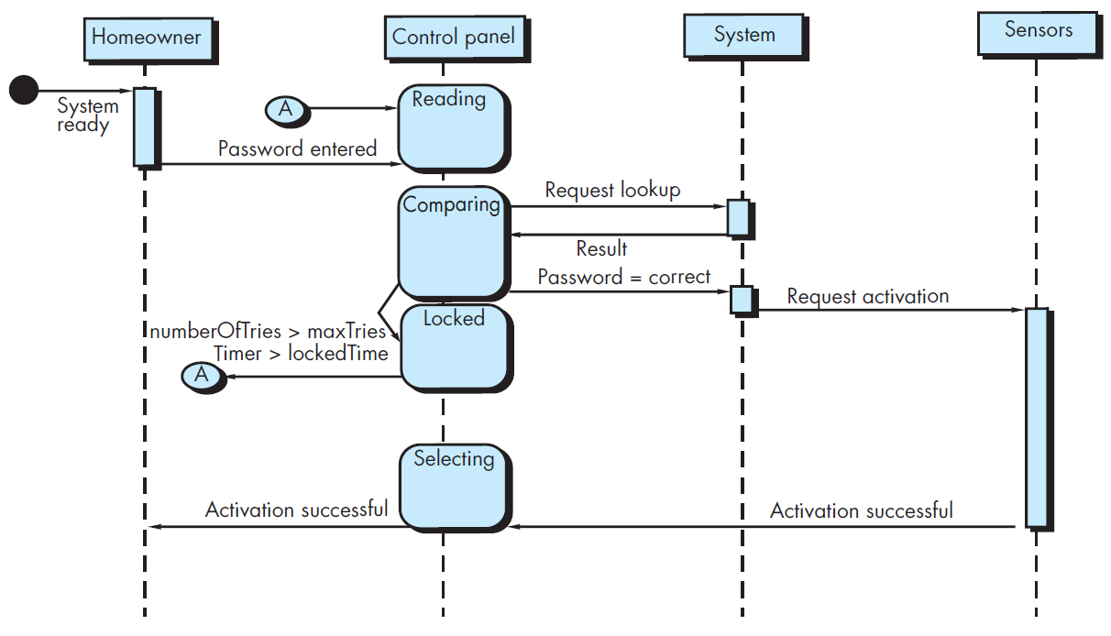
Sequence Diagrams
Indicates how events cause transitions from object to object
Once events have been identified by examining a use case, the modeler creates a sequence diagram—a representation of how events cause flow from one object to another as a function of time

Slide 27
Class diagram – Self study

Slide 28
Summary
Behavioral modeling during requirements analysis depicts dynamic behavior of the software
The behavioral model uses input from scenario-based or class based elements to represent the states of analysis classes and the system as a whole
To accomplish this, states are identified, the events that cause a class (or the system) to make a transition from one state to another are defined, and the actions that occur as transition is accomplished are also identified
Sequence diagrams are the notation used for behavioral modeling

